Slide 1
Data Link Layer Bridges
LECTURE 07

Slide 2
Contents
MAC-sublayer interconnection
Virtual LAN (VLAN)
Bridges and Bridged Networks
Basic Bridge Operation
Spanning Tree Protocol

Slide 3
MAC-sublayer interconnection
Bridges and bridged IEEE 802 networks

Slide 4
IEEE 802-2014 Overview and Architecture 3. Definitions, acronyms and abbreviations 3.1 Definitions
access domain:
A set of stations in an IEEE 802 network together with interconnecting data transmission media and functional units (e.g., repeaters), in which the stations use the same medium access control (MAC) protocol to communicate over a common physical medium.
bridge:
A functional unit that interconnects two or more IEEE 802 networks that use the same data link layer (DLL) protocols above the medium access control (MAC) sublayer, but can use different MAC protocols.
Forwarding and filtering decisions are made on the basis of layer 2 information.

Slide 5
IEEE 802-2014 Overview and Architecture 5.3.2 MAC-sublayer interconnection: Bridges 5.3.2.1 Bridges and bridged IEEE 802 networks
Bridges are stations that interconnect multiple access domains.
IEEE Std 802.1D provides the basic specification for bridge interworking among IEEE 802 networks.
A bridged IEEE 802 network consists of one or more bridges together with the complete set of access domains that bridges interconnect.
A bridged IEEE 802 network provides end stations belonging to any of its access domains with the connectivity of a network that contains the whole set of attached end stations.
IEEE Std 802.1Q adds additional capabilities to the bridge specification in IEEE Std 802.1D including virtual local area networks (VLANs), priorities, and provider bridging.

Slide 6
IEEE 802-2014 Overview and Architecture 5.3.2 MAC-sublayer interconnection: Bridges 5.3.2.1 Bridges and bridged IEEE 802 networks
A bridged network can provide for the following:
Communication between stations attached to networks of different MAC types that conform to the Internal Sublayer Service as specified in IEEE Std 802.1AC.
An increase in the total throughput of a network over that of a purely shared media network.
An increase in the physical extent of, or number of permissible attachments to, a network.
Partitioning of the physical network for administrative or maintenance reasons.

Slide 7
IEEE 802-2014 Overview and Architecture 5.3.2 MAC-sublayer interconnection: Bridges 5.3.2.2 Bridge relaying and filtering
A bridge processes protocols in the MAC sublayer and is functionally transparent to LLC sublayer and higher layer protocols.
MAC frames are forwarded between access domains or filtered on the basis of addressing and protocol information contained in the MAC frame.
Filtering by bridges tends to confine traffic to only the parts of the bridged network (that lie between transmitting end stations and the intended receivers).

Slide 8
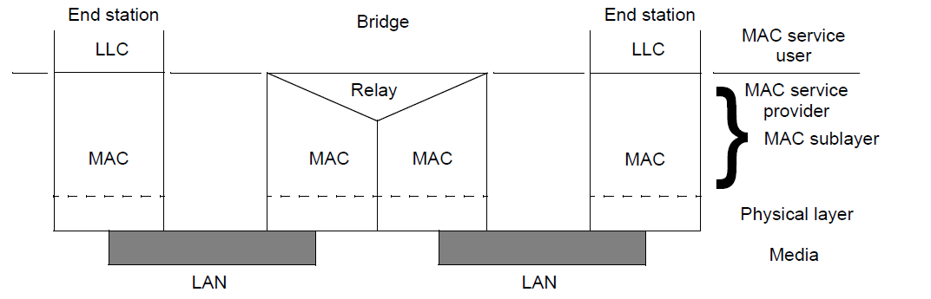
IEEE 802-2014 Overview and Architecture 5.3.2 MAC-sublayer interconnection: Bridges 5.3.2.2 Bridge relaying and filtering
Figure 7—Internal organization of the MAC sublayer with bridging

Slide 9
IEEE 802-2014 Overview and Architecture 5.3.2 MAC-sublayer interconnection: Bridges 5.3.2.3 Resolving topologies with multiple paths
A key aspect of IEEE Std 802.1D and IEEE Std 802.1Q is the specification of the rapid spanning tree protocol (RSTP).
The RSTP is used by bridges to configure their interconnections in order to prevent looping data paths in the bridged IEEE 802 network.
If the basic interconnection topology of bridges and networks contains multiple possible paths between certain points, use of the RSTP blocks some paths in order to produce a simply connected active topology for the flow of MAC user traffic between end stations.
For each point of attachment of a bridge to a network, the RSTP selects whether MAC user traffic is to be received and transmitted by the bridge at that point of attachment.

Slide 10
IEEE 802-2014 Overview and Architecture 5.3.2 MAC-sublayer interconnection: Bridges 5.3.2.3 Resolving topologies with multiple paths
IEEE Std 802.1Q specifies a variant of RSTP
Multiple spanning tree protocol (MSTP)
The MSTP can configure multiple, independent spanning trees within a bridged network.
Shortest path bridging (SPB)
The SPB allows the use of shortest path communication within administratively defined network regions, while retaining concurrent support for all existing spanning tree protocols.
The use of shortest path bridging, both for unicast and multicast, allows multiple paths to be used simultaneously.

Slide 11
IEEE 802-2014 Overview and Architecture 5.3.2 MAC-sublayer interconnection: Bridges 5.3.2.4 Transparent bridging
IEEE Std 802.1D and IEEE Std 802.1Q specify transparent bridging operation.
The MAC bridging function does not require the MAC user frames transmitted and received to carry any additional information relating to the operation of the bridging functions.
Self-learning bridges
End-station operation is unchanged by the presence of bridges.

Slide 12
IEEE 802-2014 Overview and Architecture 5.3.2 MAC-sublayer interconnection: Bridges 5.3.2.5 Provider bridging
IEEE Std 802.1Q specifies the method by which the MAC service is supported by virtual bridged LANs, the principles of operation of those networks, and the operation of VLAN-aware bridges, including management, protocols, and algorithms.
The standard also enables a service provider to use the architecture and protocols specified in order to offer the equivalent of separate LANs, bridged LANs, or virtual bridged LANs to a number of customers, while requiring no cooperation between the customers and minimal cooperation between each customer and the service provider.

Slide 13
IEEE 802.1Q-2018
Bridges and Bridged Networks

Slide 14
IEEE 802.1Q-2018 Bridges and Bridged Networks 3. Definitions
3.290 Virtual Local Area Network (VLAN):
The closure of a set of Media Access Control (MAC) Service Access Points (MSAPs) such that a data request in one MSAP in the set is expected to result in a data indication in another MSAP in the set.
3.286 Virtual Bridged Network:
A concatenation of individual IEEE 802 Local Area Networks (LANs) interconnected by Bridges, including Virtual Local Area Network (VLAN) Bridges.

Slide 15
IEEE 802.1Q-2018 Bridges and Bridged Networks VLAN
A virtual local area network (VLAN) is any broadcast domain that is partitioned and isolated in a computer network at the data link layer (OSI layer 2).
Creating the appearance and functionality of network traffic that is physically on a single network but acts as if it is split between separate networks.
VLANs allow network administrators to group hosts together even if the hosts are not directly connected to the same network switch.
Because VLAN membership can be configured through software, this can greatly simplify network design and deployment.
https://en.wikipedia.org/wiki/VLAN

Slide 16
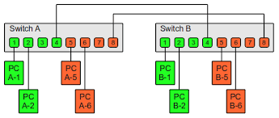
IEEE 802.1Q-2018 Bridges and Bridged Networks VLAN Example
https://www.thomas-krenn.com/en/wiki/VLAN_Basics

Slide 17
IEEE 802.1Q-2018 Bridges and Bridged Networks 6. Support of the MAC Service
VLAN Bridges interconnect the separate IEEE 802 LANs that compose a Virtual Bridged Network by relaying and filtering frames between the separate MACs of the bridged LANs.
The MAC Sublayer comprises
a) Media access method-specific functions that realize transmission and reception of MAC Protocol Data Units (MPDUs).
b) Media access method-dependent convergence functions that use item a) to provide a media access method-independent service.
c) Media access method-independent functions that use a media-independent service to provide the same or another media-independent service.

Slide 18
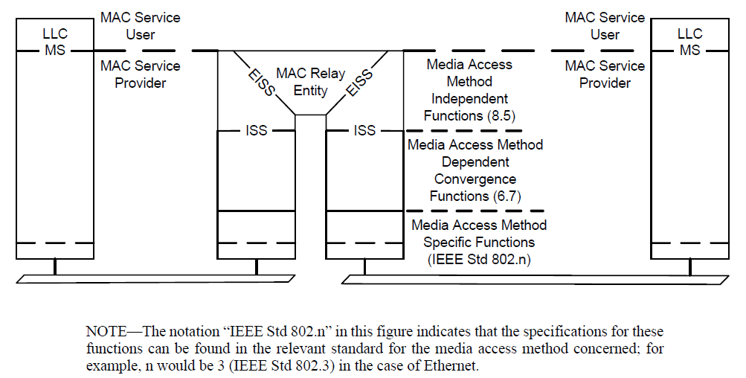
IEEE 802.1Q-2018 Bridges and Bridged Networks 6. Support of the MAC Service
IEEE Std 802.1AC
Figure 6-1—Internal organization of the MAC sublayer
EISS Enhanced Internal Sublayer Service

Slide 19
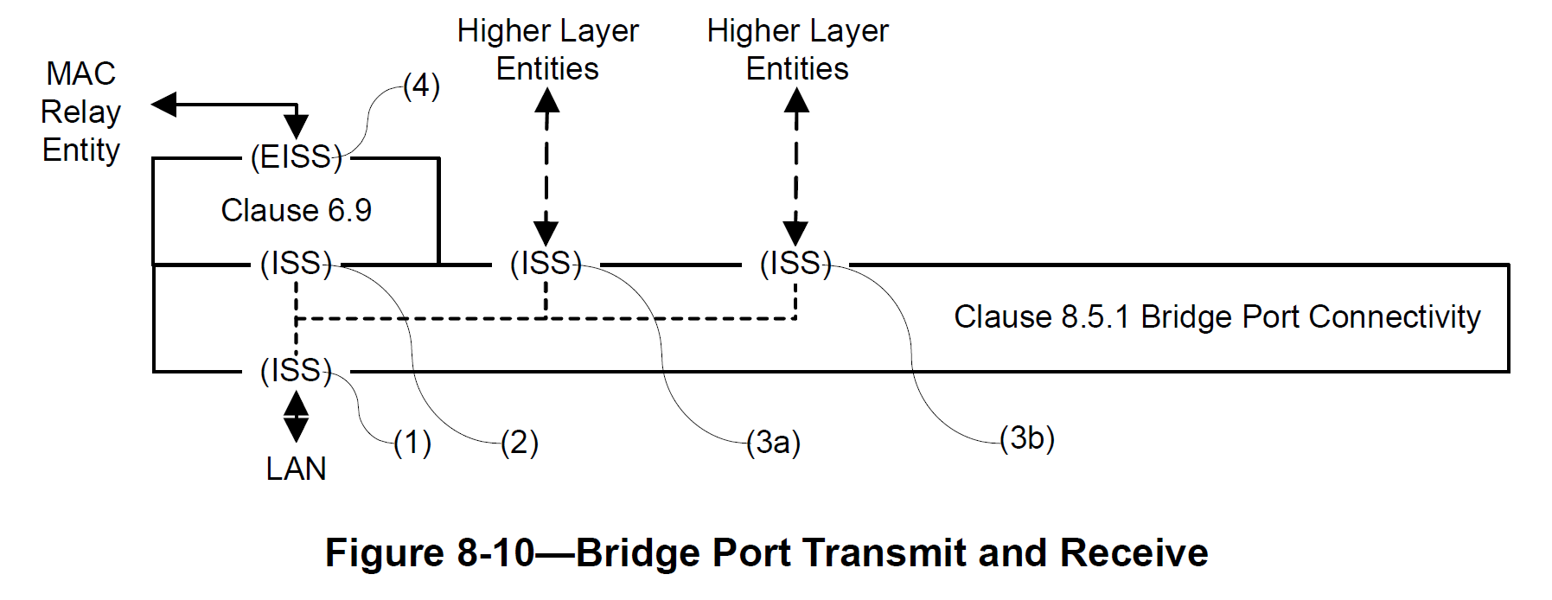
IEEE 802.1Q-2018 Bridges and Bridged Networks 8. Principles of Bridge operation 8.5.1 Bridge Connectivity
Bridge Port only
No M_UNITDATA.indication for Two Port Mac Relay (TPMR)
M_UNITDATA.indication
M_UNITDATA.indication
M_UNITDATA.request
M_UNITDATA.indication
M_UNITDATA.indication
M_UNITDATA.indication
M_UNITDATA.indication
M_UNITDATA.request
6.9 Support of the EISS

Slide 20
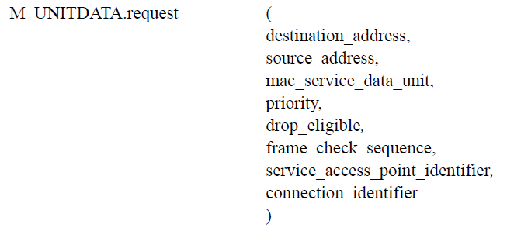
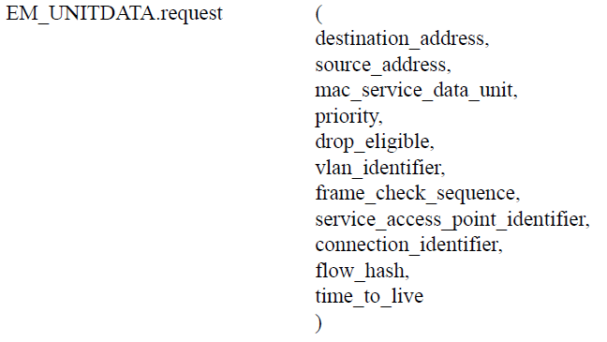
IEEE 802.1Q-2018 Bridges and Bridged Networks 6. Support of the MAC Service 6.8 Enhanced Internal Sublayer Service (EISS)
The destination_address, source_address, mac_service_data_unit, priority, drop_eligible, service_access_point_identifier, connection_identifier, and frame_check_sequence parameters are as defined for the ISS.
The flow_hash parameter either is null or carries a value that may be used by the forwarding process in selecting a single forwarding port from a set of available forwarding ports.
Transmission order is maintained for all frames from a source to a destination with the same flow hash value.
A flow hash value may be retrieved from an F-TAG (F-TAG flow filtering tag_ or otherwise derived from the contents of a service primitive

Slide 21
IEEE 802.1Q-2018 Bridges and Bridged Networks 6. Support of the MAC Service 6.8 Enhanced Internal Sublayer Service (EISS)
The vlan_identifier parameter carries the VID.
The flow_hash parameter either is null or carries a value that may be used by the forwarding process in selecting a single forwarding port from a set of available forwarding ports.
Transmission order is maintained for all frames from a source to a destination with the same flow hash value.
A flow hash value may be retrieved from an F-TAG or otherwise derived from the contents of a service primitive.
It is required for flow filtering services supported by SPBM with ECMP.
The time_to_live parameter either is null or carries a value that may be used to filter frames that have reached their limit of permitted network hops (default:8).
A time_to_live value may be retrieved from an F-TAG in the mac_service_data_unit
F-TAG flow filtering tag
SPBM Shortest Path Bridging MAC
ECMP Equal Cost Multiple Paths
VID VLAN Identifier

Slide 22
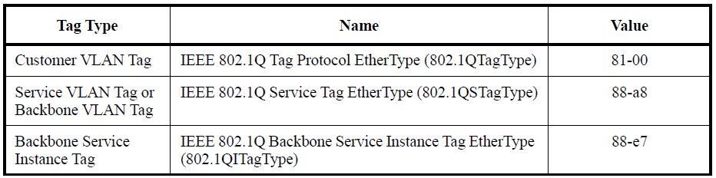
IEEE 802.1Q-2018 Bridges and Bridged Networks 9.3 Tag format
Each tag comprises the following sequential information elements:
a) A Tag Protocol Identifier (TPID)
b) Tag Control Information (TCI) that is dependent on the tag type
c) Additional information, if and as required by the tag type and TCI
Table 9-1—IEEE 802.1Q EtherType allocations
C-TAG
S-TAG
I-TAG

Slide 23
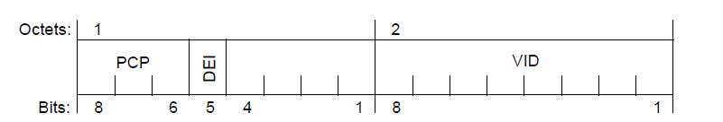
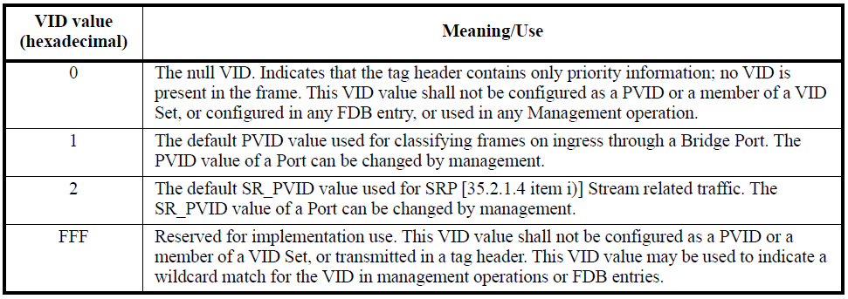
IEEE 802.1Q-2018 Bridges and Bridged Networks 9.3 Tag format 9.6 VLAN Tag Control Information (TCI)
Figure 9-1—VLAN TCI format
Table 9-2—Reserved VID values
PVID port VLAN Identifier
SR_PVID Stream Reservation Port VLAN Identifier

Slide 24
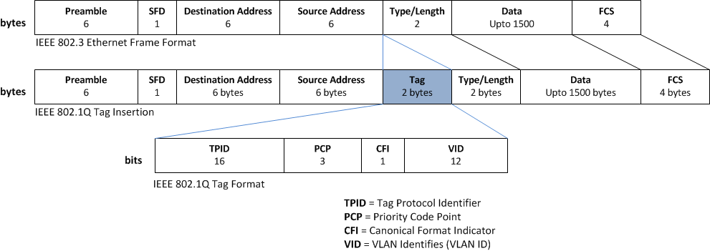
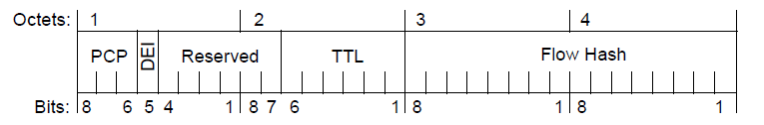
IEEE 802.1Q-2018 Bridges and Bridged Networks VLAN frame format example
IEEE802.3 MAC frame
C-VLAN
Tag
(TPID+TCI)
Tag Control Information (TCI)
DEI
1
F-TAG
0x894B
C-LAN Tag
EtherType
(0x8100)
DEI=drop_eligible Indicator
Tags are encoded in the mac_service_data_unit parameter

Slide 25
IEEE 802.1Q-2018 Bridges and Bridged Networks 7. Principles of Virtual Bridged Network operation 7.1 Network overview
The operation of a Virtual Bridged Network, the Bridges, and the LANs (that compose that network) comprises
a) A physical topology comprising LANs, Bridges, and Bridge Ports.
Each Bridge Port attaches a LAN to a Bridge and is capable of providing bidirectional connectivity for MAC user data frames.
b) Calculation of one or more active topologies, each a loop-free subset of the physical topology.
c) Rules for the classification of MAC user data frames that allow each Bridge to allocate, directly or indirectly, each frame to one and only one active topology.

Slide 26
IEEE 802.1Q-2018 Bridges and Bridged Networks 7. Principles of Virtual Bridged Network operation 7.1 Network overview
The operation of a Virtual Bridged Network, the Bridges, and the LANs (that compose that network) comprises
d) Management control of the connectivity provided for differently classified data frames by the selected active topology.
e) Implicit or explicit configuration of end station location information, identifying LANs with attached end stations that need to receive user data frames with a given destination address.
f) Communication of end station location information to allow Bridges to restrict user data frames to LANs in the path provided to their destination(s) by the chosen active topology.

Slide 27
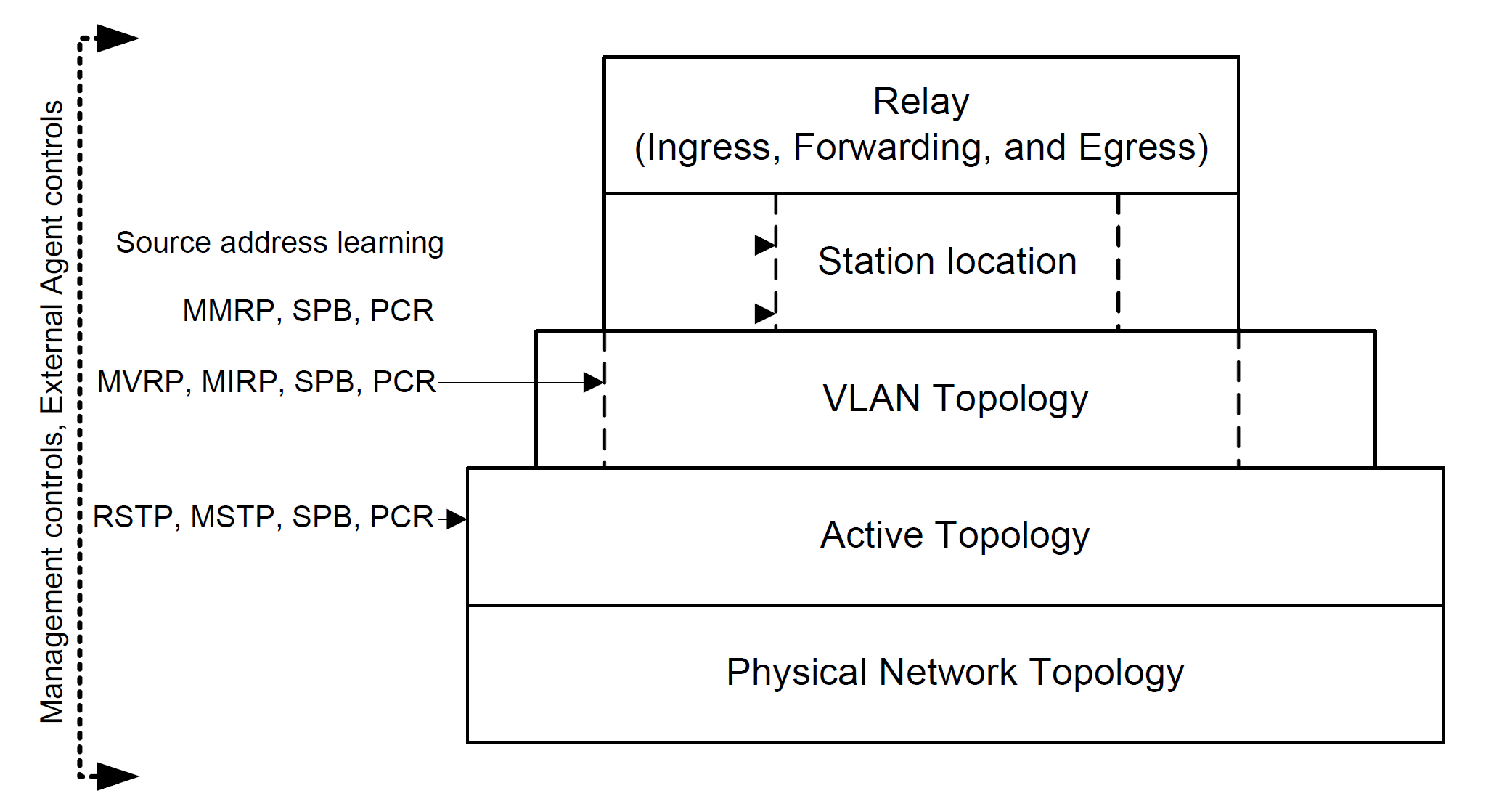
IEEE 802.1Q-2018 Bridges and Bridged Networks 7. Principles of Virtual Bridged Network operation
Implicit
Explicit
Selecting a spanning tree with a VID
MVRP: Multiple VLAN Registration Protocol
MIRP: Multiple I-SID Registration Protocol
(I-SID Backbone Service Instance Identifier)
MMRP: Multiple MAC Registration Protocol
RSTP: Rapid Spanning Tree Algorithm and Protocol
MSTP: Multiple Spanning Tree Algorithm and Protocol
SPB: Shortest Path Bridging
PCR: Path Control and Reservation (traffic stream)
Creating spanning trees with spanning tree protocols (RSTP, MSTP, STB)
Figure 7-1—VLAN Bridging overview

Slide 28
IEEE 802.1Q-2018 Bridges and Bridged Networks 7. Principles of Virtual Bridged Network operation 7.2 Use of VLANs
VLANs and their VIDs provide a convenient and consistent network-wide reference for VLAN Bridges to
Identify rules for the classification of user data frames into VLANs
Effectively extend the source and destination MAC addresses, by treating frames and addressing information for different VLANs independently
Identify and select from different active topologies.
Identify configuration parameters that partition a physical network.

Slide 29
IEEE 802.1Q-2018 Bridges and Bridged Networks 7. Principles of Virtual Bridged Network operation 7. Active topology3
Bridges cooperate to calculate one or more loop-free and fully connected active topologies.
The algorithms and protocols provide rapid recovery from network component failure by using alternate physical connectivity, without requiring management intervention.
RSTP (13.4), MSTP (13.5), SPB (Clause 27), PCR (Clause 45)
The Bridge’s forwarding processes constrain the potential path for each user data frame to a single spanning tree.
RSTP: Rapid Spanning Tree Algorithm and Protocol
MSTP: Multiple Spanning Tree Algorithm and Protocol
SPB: Shortest Path Bridging
PCR: Path Control and Reservation (traffic stream)

Slide 30
IEEE 802.1Q-2018 Bridges and Bridged Networks 7. Principles of Virtual Bridged Network operation 7.4 VLAN topology
Typically, each of the VIDs for frames (assigned to the CST, and to the IST (CIST (RSTP)) or an MSTI within an MST Region) supports a different VLAN.
Each VLAN is supported by only one VID and only one subtree within the region.
Each VLAN may occupy the full extent of the active topology of its associated spanning tree(s) or a continuously connected subset of that active topology.
The dynamic determination of VLAN extent provides flexibility and bandwidth conservation, at the cost of network management complexity.
Static VLAN Registration Entries in the FDB (Filtering Database)
Dynamic VLAN Registration Entries managed by Multiple VLAN Registration Protocol (MVRP)

Slide 31
IEEE 802.1Q-2018 Bridges and Bridged Networks 7. Principles of Virtual Bridged Network operation 7.5 Locating end stations
Functioning as a distributed system, Bridges within the current extent of a VLAN can locate those LANs (where an attached end station or end stations are intended to receive frames addressed to a specified individual address or group address).
Bridges can reduce traffic by confining frames to the LANs where their transmission is necessary.
The Multiple MAC Registration Protocol (MMRP) allows end stations to advertise their presence and their desire to join (or leave) a multicast group, or to register an individual MAC address, in the context of a VLAN.
The protocol communicates this information to other Bridges, using the VLAN and its active topology.

Slide 32
IEEE 802.1Q-2018 Bridges and Bridged Networks 7. Principles of Virtual Bridged Network operation 7.5 Locating end stations
Each end station implicitly advertises its attachment to an individual LAN and its individual MAC address whenever it transmits a frame.
Bridges learn from the source address as Bridges forward the frame along the active topology to its destination or destinations (or throughout the Bridged Network or VLAN if the location of the destination or destinations is unknown.
The learned information is stored in the FDB and used to filter frames on the basis of their destination addresses.
Address information learned from a frame with a given VID can be used to filter frames with other VIDs.

Slide 33
IEEE 802.1Q-2018 Bridges and Bridged Networks 7. Principles of Virtual Bridged Network operation 7.6 Ingress, forwarding, and egress rules
The relay function provided by each Bridge controls the following:
a) (the ingress rules) Classification of each received frame as belonging to one and only one VLAN, and discard or acceptance of the frame for further processing on the basis of that classification and the received frame format, which can be one of three possible types:
1) Untagged, and not explicitly identifying the frame as being associated with a particular VID.
2) Priority-tagged, including a tag header conveying explicit priority information but not identifying the frames as being associated with a specific VID.
3) VLAN-tagged, explicitly associating the frames with a particular VID.

Slide 34
IEEE 802.1Q-2018 Bridges and Bridged Networks 7. Principles of Virtual Bridged Network operation 7.6 Ingress, forwarding, and egress rules
The relay function provided by each Bridge controls the following:
b) (the forwarding rules) Implementation of the decisions governing where each frame is to be forwarded as determined by the current extent of the VLAN topology, station location information, and the additional management controls.
c) (the egress rules) Queuing of frames for transmission through the selected Bridge Ports, management of the queued
frames, selection of frames for transmission, and determination of the appropriate frame format type, VLAN-tagged or untagged.

Slide 35
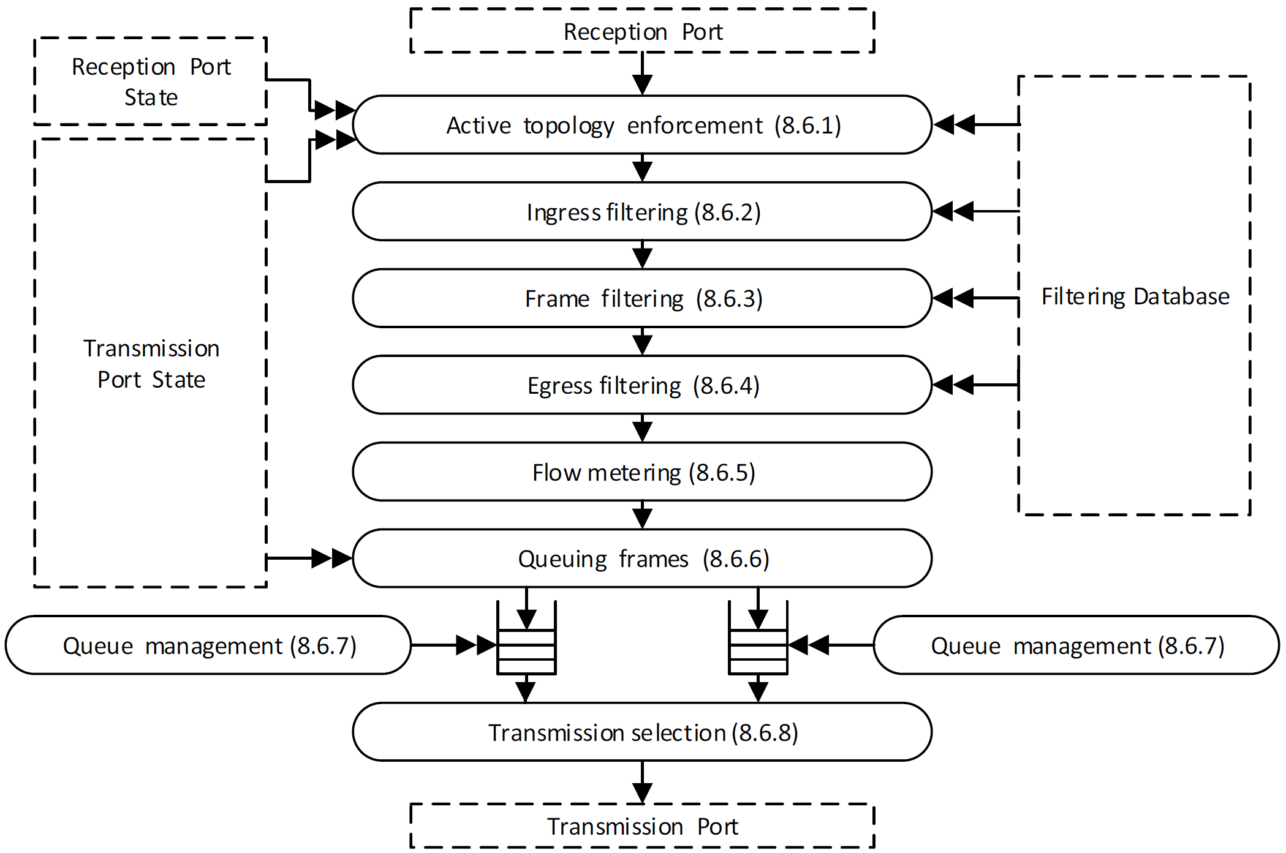
IEEE 802.1Q-2018 8. Principles of Bridge operation 8.6 The Forwarding Process
Figure 8-12—Forwarding process functions

Slide 36
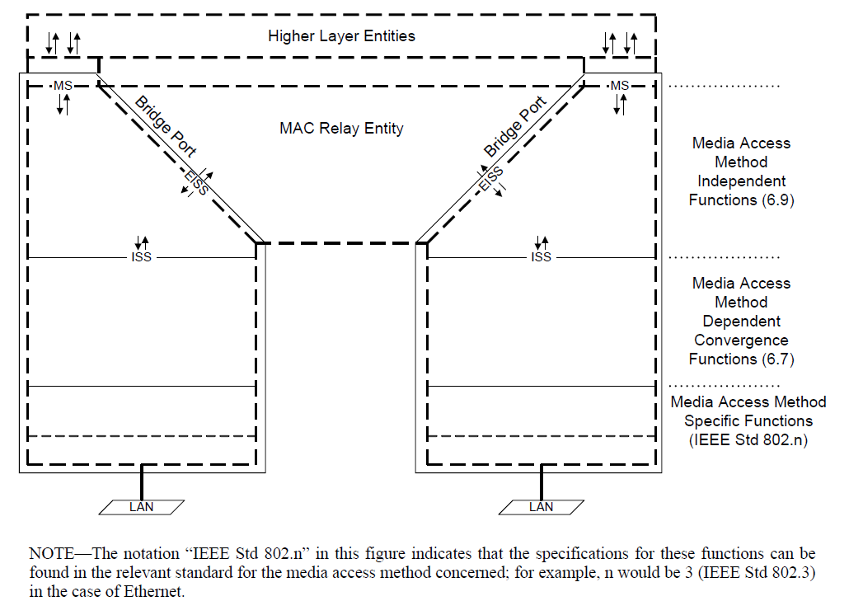
IEEE 802.1Q-2018 Bridges and Bridged Networks 8. Principles of Bridge operation 8.2 Bridge architecture
Higher layer entities, including at least a Spanning Tree Protocol Entity
Figure 8-2—VLAN Bridge architecture

Slide 37
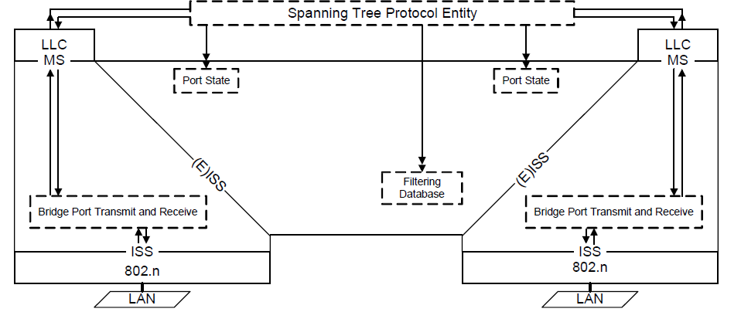
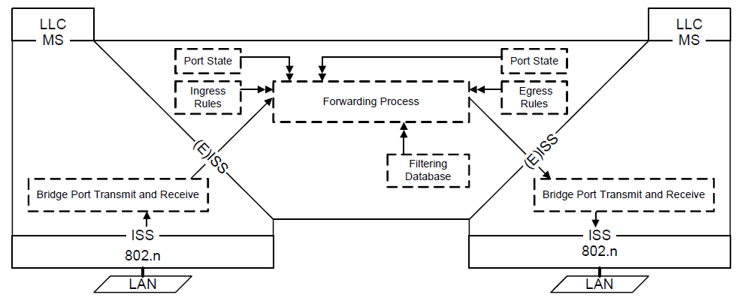
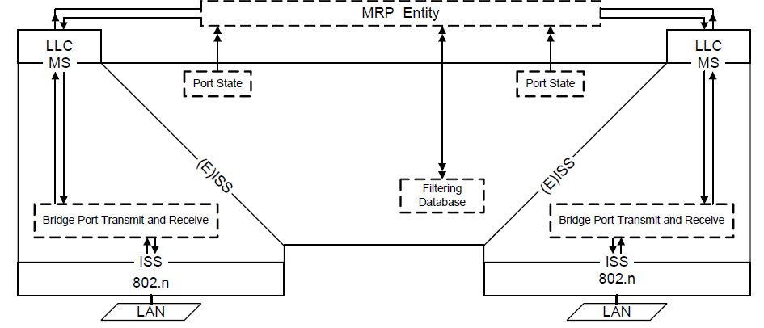
IEEE 802.1Q-2018 Bridges and Bridged Networks 8. Principles of Bridge operation 8.2 Bridge architecture
Figure 8-6—Operation of Spanning Tree Protocol Entity
Figure 8-4—Relaying MAC frames
Figure 8-7—Operation of MRP (MMRP,MVRP, MSRP)

Slide 38
IEEE 802.1Q-2018 Bridges and Bridged Networks
13. Spanning tree protocols
13.4 Rapid Spanning Tree Protocol (RSTP)

Slide 39
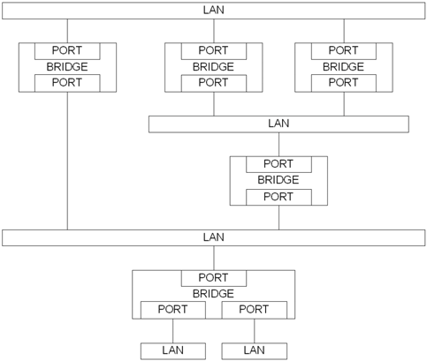
IEEE 802.1Q-2018 Bridges and Bridged Networks 13. Spanning tree protocols of Bridge operation
Figure 8-1—A Bridged Network

Slide 40
IEEE 802.1Q-2018 Bridges and Bridged Networks 13. Spanning tree protocols of Bridge operation
The spanning tree algorithms and protocols provide simple and full connectivity throughout a Bridged Network comprising arbitrarily interconnected Bridges.
Each Bridge can use
Rapid Spanning Tree Algorithm and Protocol (RSTP),
Multiple Spanning Tree Algorithm and Protocol (MSTP), or
Shortest Path Bridging (SPB) protocols.

Slide 41
IEEE 802.1Q-2018 Bridges and Bridged Networks 13. Spanning tree protocols of Bridge operation
RSTP assigns all frames to a Common Spanning Tree (CST), without being aware of the active topology assignments made by MSTP or SPB (that allow frames to follow separate paths within Multiple Spanning Tree (MST) or Shortest Path Tree (SPT) Regions.
The connectivity calculated for the CIST provides the CST for interconnecting the regions, and an Internal Spanning Tree (IST) within each region.

Slide 42
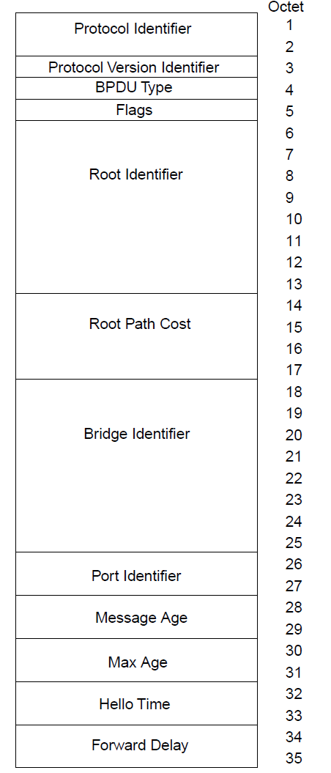
IEEE 802.1Q-2018 Bridges and Bridged Networks STP BPDUs (IEEE 802.1D-1998)
The Protocol Identifier (0x0000: the Spanning Tree Algorithm and Protocol)
b) The Protocol Version Identifier (0x00) 00.
c) The BPDU Type (0x00: Configuration BPDU)
d) The Topology Change Acknowledgment flag (Bit 8 of Octet 5).
e) The Topology Change flag (Bit 1 of Octet 5)
f) The Root Identifier (8 octets : priority (2)+MAC Address (6))
g) The Root Path Cost (4 octets)
h) The Bridge Identifier (8 octets : priority (2)+MAC Address (6))
i) The Port Identifier (2 octets : priority(1)+port number(1))
j) The Message Age timer value (2 octets < Max Age).
k) The Max Age timer value (2 octets).
l) The Hello Time timer value (2 octets)
m) The Forward Delay timer value (2 octets).

Slide 43
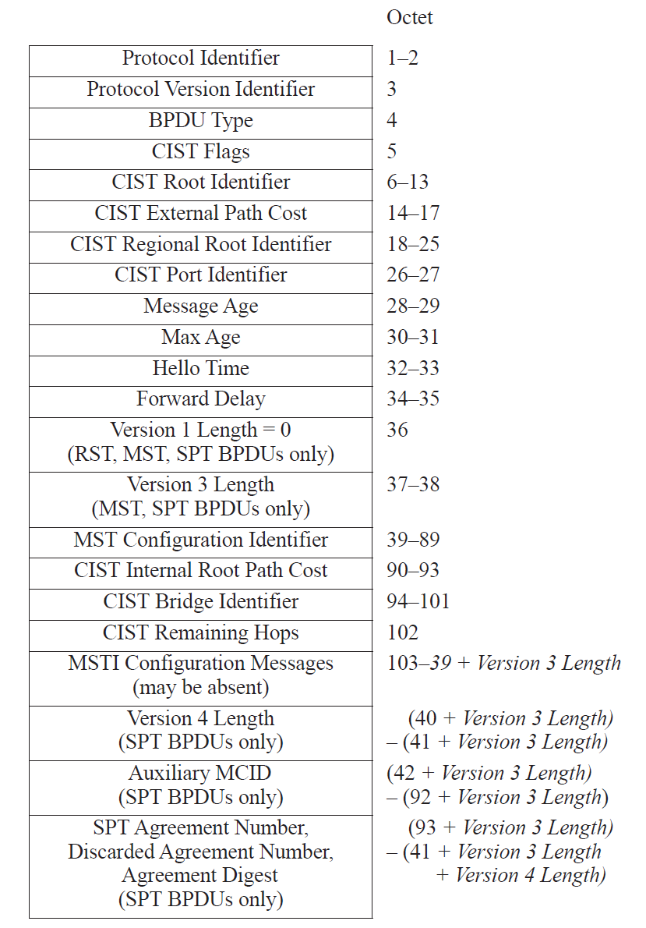
IEEE 802.1Q-2018 Bridges and Bridged Networks 14. Encoding of Bridge Protocol Data Units (BPDUs) 14.1 BPDU Structure
CIST Root Identifier (Root Bridge Identifier)
CIST External Path Cost (Root Path Cost)
CIST Regional Root Identifier (MSTP)
CIST Internal Root Path Cost (MSTP)
CIST Bridge Identifier (Designated Bridge Identifier)
CIST Port Identifier (Designated Port Identifier)

Slide 44
IEEE 802.1Q-2018 Bridges and Bridged Networks 8. Principles of Bridge operation 8.4 Active topologies, learning, and forwarding
The term Port State summarizes per-tree combinations of forwarding and learning, and any additional per-tree variables used by a given spanning tree protocol to enforce the active topologies it has calculated.
Any port (that has learning and forwarding disabled) is assigned the Port State Discarding.
A Port (that has learning enabled but forwarding disabled) has the Port State Learning.
A Port (that both learns and forwards frames) has the Port State Forwarding.

Slide 45
IEEE 802.1Q-2018 Bridges and Bridged Networks 13. Spanning tree protocols 13.12 Port Role assignments
Each Bridge assigns CIST Port Roles.
The calculations (specified in 13.10 CIST Priority Vector calculations) are used to assign a role to each Bridge Port that is enabled as follows:
a) If the Bridge is not the CIST Root, the source of the root priority vector (RPV) is the Root Port. (the Rx Port of the RPV)
b) Each port (whose port priority vector (PPV) is the designated priority vector (DPV) is a Designated Port.
c) Each port, (other than the Root Port) with a port priority vector received from another Bridge is an Alternate Port.
d) Each port with a port priority vector received from another port on this Bridge is a Backup Port.

Slide 46
IEEE 802.1Q-2018 Bridges and Bridged Networks 13. Spanning tree protocols 13.4 RSTP overview
RSTP configures the Port State of each Bridge Port in the Bridge Local Area Network.
Each of the Bridges in the network transmits Configuration Messages.
Each message contains spanning tree priority vector information that identifies one Bridge as the Root Bridge of the network.
Each message allows each Bridge to compute its own lowest path cost to that Root Bridge before transmitting its own Configuration Messages.
A Port Role of Root Port is assigned to the one port on each Bridge [that provides the lowest cost path to the Root Bridge].

Slide 47
IEEE 802.1Q-2018 Bridges and Bridged Networks 13. Spanning tree protocols 13.4 RSTP overview
Each of the Bridges in the network transmits Configuration Messages.
A Port Role of Designated Port is assigned to the one Bridge Port [that provides the lowest cost path from the attached LAN to the Root Bridge.
Alternate Port and Backup Port roles are assigned to Bridge Ports that can provide connectivity if other network components fail.
Root Ports and Designated Ports are Forwarding
Alternate, Backup, and Disabled Ports are Discarding

Slide 48
IEEE 802.1Q-2018 Bridges and Bridged Networks 14.2.5 Encoding of Bridge Identifiers 14.2.7 Encoding of Port Identifiers
A Bridge Identifier is a 64-bit unsigned integer.
4bits (the bridge priority)
2bits (the locally assigned system ID extension(0))
48bits (the unique Bridge Identifier)
A Port Identifier is a 16-bit unsigned integer.
4bits (The port priority)
The relative priority of ports on the same Bridge.
12 bits (the port identifier)
value 0 is not used as a Port Number.
If two Bridge (or Port) Identifiers are numerically compared, the lesser number denotes the Bridge of the better priority.

Slide 49
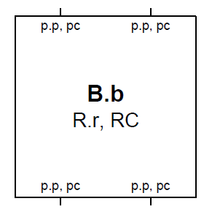
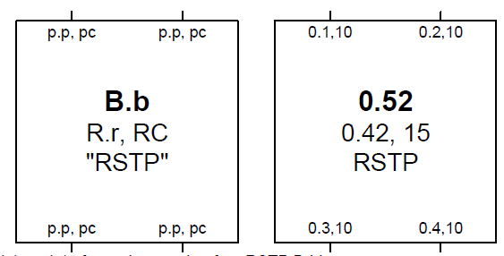
IEEE 802.1Q-2018 Bridges and Bridged Networks 13. Spanning tree protocols 13.4 RSTP overview
A template for and example of an STP Bridge
B.b is the Bridge Identifier (including the manageable priority component B.).
R.r and RC are the Root Identifier, Root Path Cost, and the Designated Bridge Identifier, for the Root Port.
p.p, pc are the Port Identifier (with manageable priority p.) and the Port Path Cost for a Bridge Port.
A template for and example of an RSTP Bridge.

Slide 50
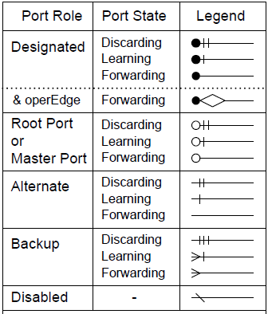

IEEE 802.1Q-2018 Bridges and Bridged Networks 13. Spanning tree protocols 13.4 RSTP overview
A LAN
Connections between Bridges and LANs indicate the Port Role and Port State by means of their end point symbols

Slide 51
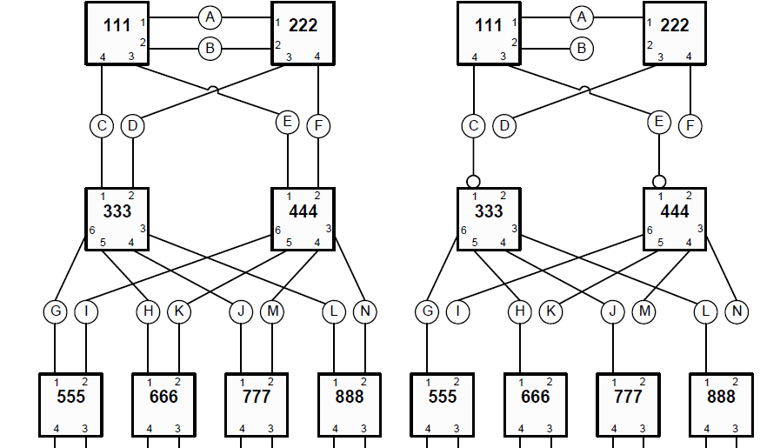
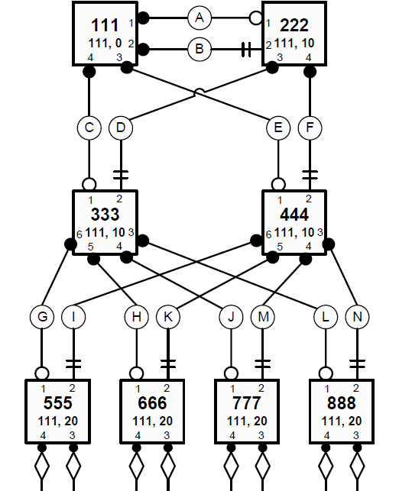
IEEE 802.1Q-2018 Bridges and Bridged Networks 13. Spanning tree protocols 13.4 RSTP overview
Figure 13-2—Physical topology and active topology
Figure 13-3—Port Roles and Port States

Slide 52
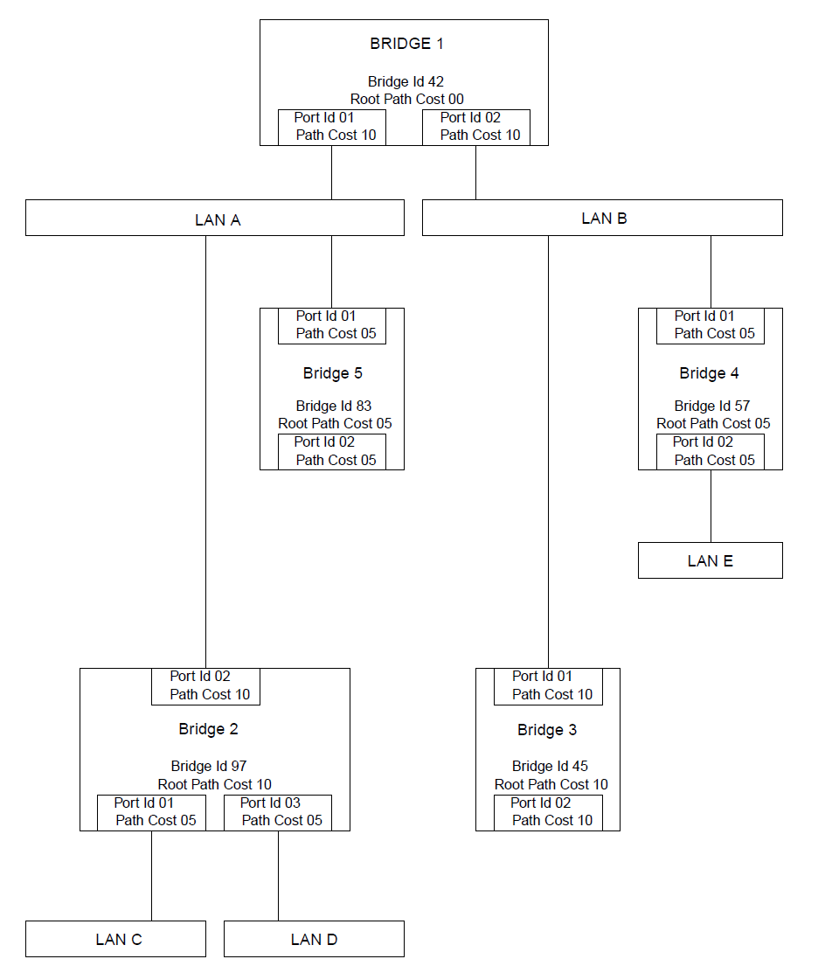
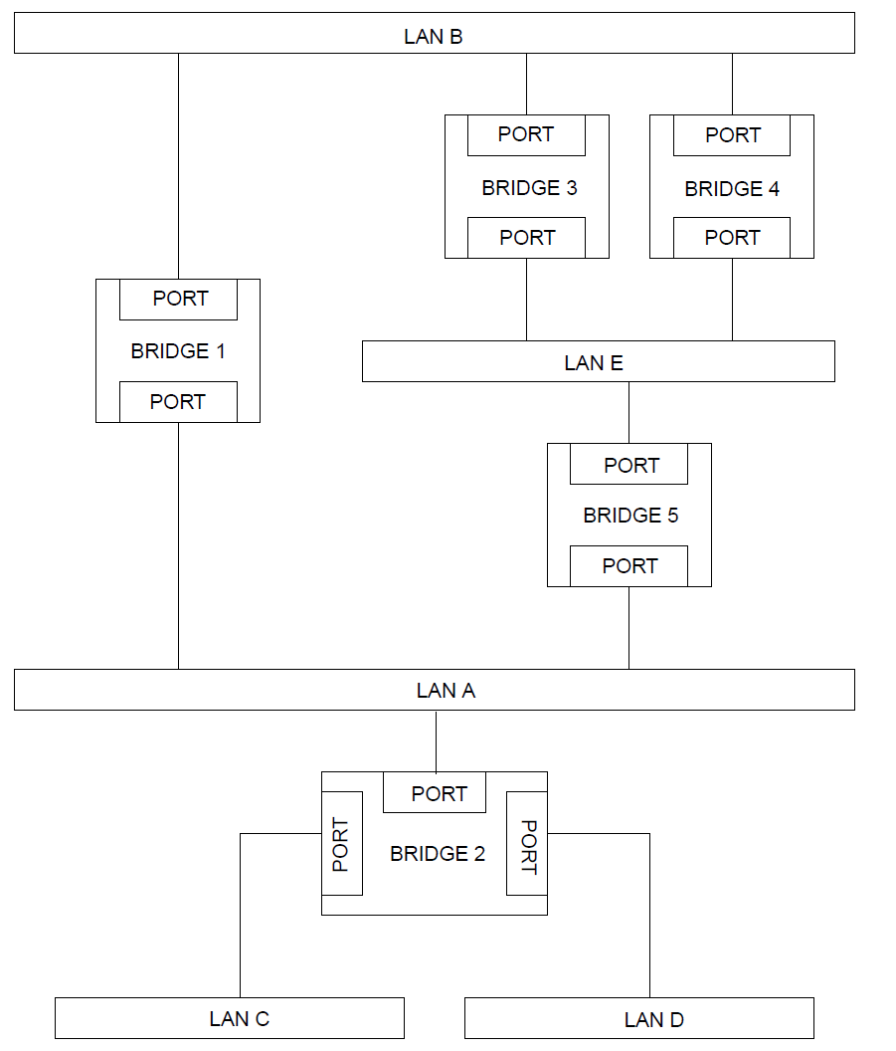
Rapid Spanning tree protocol (RSTP) - generating CST (omitting IST part)

Slide 53
Rapid Spanning tree protocol (RSTP) - generating CST (omitting IST part)
A Bridge (that believes itself to be the Root) originates Configuration BPDU on all the LANs to which it is attached, at regular intervals.
If(a Bridge receives superior information on a port) then
It decides the receiving port as its Root Port
The root bridge identifier,
The root path cost,
The bridge identifier (between bridges)
The Port identifier (within a bridge)
It passes that information on to all the LANs for which it believes itself to be the Designated Bridge.

Slide 54
Rapid Spanning tree protocol (RSTP) - generating CST (omitting IST part)
If(a Bridge receives inferior information on a Port attached to a LAN), the Port considers to be the Designated Port on the LAN.
It transmits its own information for all other Bridges via the port attached to the LAN.

Slide 55
IEEE 802.1Q-2018 Rapid Spanning Tree Protocol (RSTP)
Each Port has the port priority vector (PVP)
{RID : RPC : DID : PID : RxPID}
RID: Root Bridge ID for the root bridge the sending bridge recognized
RPC: Root Path Cost from this bridge
DID: Designated bridge to the LAN
DP: Designated to the LAN
RXPID: the port ID of this bridge received this MPV.
Initial port priority vector: {self:0:Self: this port: this port}

Slide 56
IEEE 802.1Q-2018 Rapid Spanning Tree Protocol (RSTP)
The message priority vector (MPV) is the priority vector conveyed in a received Configuration Message.
{RID : RPC : DID : PID : RxPID}
If the message priority vector received in a Configuration Message from a Designated Port is superior, it will replace the current port priority vector.

Slide 57
IEEE 802.1Q-2018 Rapid Spanning Tree Protocol (RSTP)
A root path priority vector (RPPV) for a port can be calculated from a port priority vector that contains information from a message priority vector, as follows:
{RID : RPC+PPC : DID : PID : RxPID}
PPC: the Port Path Cost of the RxPID
Each Bridge has the bridge priority vector (BPV)
{B : 0 : B : 0 : 0}, RID=DID= this Bridge ID (B)

Slide 58
Rapid Spanning tree protocol (RSTP) - generating CST (omitting IST part)
The root priority vector (RPV) for Bridge B is the superior priority vector of the set of priority vectors comprising
a) The Bridge priority vector;
{B : 0 : B : 0 : 0},
b) All root path priority vectors (RPPVs) that
1) Have a Designated Bridge Identifier D that is not equal to B, and
2) Were received from a Bridge Port attached to a LAN.
{RID : RPC+PPC : DID : PID : RxPID} for the superior RPPV of each RXPID
If the Bridge priority vector is the superior priority vector of this set of priority vectors, Bridge B has been selected as the CIST Root.

Slide 59
Rapid Spanning tree protocol (RSTP) - generating CST (omitting IST part)
The designated priority vector (DPV) for a port Q on Bridge B is the root priority vector with B’s Bridge Identifier B substituted for the DesignatedBridgeID and Q’s Port Identifier Q substituted for the DesignatedPortID and RcvPortID components.
The root priority vector = {RID : RPC’: DID : PID : RxPID}
The designated priority vector = {RID : RPC’: B : Q : Q}

Slide 60
Rapid Spanning tree protocol (RSTP) - generating CST (omitting IST part)
If the designated priority vector is superior than the port priority vector and the port is attached to a LAN, the port will be the Designated Port for that LAN and the current port priority vector (PPV) will be updated.
The message priority vector in Configuration Messages (transmitted by a port) always comprises the components of the designated priority vector for the port, even if the port is a Root Port.

Slide 61
Rapid Spanning tree protocol (RSTP) - A CST example
Assumption
All LAN traverse cost = 1
All bridge & port priorities = 0
Ports of the root bridge
They are designated ports
Their Root Path Cost = 0
R=B3,RC=0,BID=B3,PID=1
R=B4,RC=0,BID=B4,PID=1
R=B1,RC=0,BID=B1,PID=1
R=B3,RC=0,BID=B3,PID=2
R=B4,RC=0,BID=B4,PID=2
R=B1,RC=0,BID=B1,PID=2
R=B5,RC=0,BID=B5,PID=1
Bridge priority vector = {self:0:self:0:0}
port priority vector (PVP) = {RID : RPC : DID : PID : RxPID}
- initial value = {self: 0: self: 0: this port ID}
message priority vector (MPV) = {RID : RPC : DID : PID : RxPID}
R=B5,RC=0,BID=B5,PID=2
R=B2,RC=0,BID=B2,PID=1
R=B2,RC=0,BID=B2,PID=2
R=B2,RC=0,BID=B2,PID=3

Slide 62
IEEE 802.1Q-2018 Rapid Spanning Tree Protocol (RSTP)
Bridge 1
BridgePV={B1:0:B1:0:0}
P1PPV={B1:0:B1:P1:P1}
P2PPV={B1:0:B1:P2:P2}
Bridge 2
BridgePV={B2:0:B2:0:0}
P1PPV={B2:0:B2:P1:P1}
P2PPV={B2:0:B2:P2:P2}
P3PPV={B2:0:B2:P3:P3}
Bridge3
BridgePV={B3:0:B3:0:0}
P1PPV={B3:0:B3:P1:P1},
P2PPV={B3:0:B3:P2:P2}
Bridge4
BridgePV={B4:0:B4:0:0}
P1PPV={B4:0:B4:P1:P1},
P2PPV={B4:0:B4:P2:P2}
Bridge5
BridgePV={B5:0:B5:0:0}
P1PPV={B5:0:B5:P1:P1},
P2PPV={B5:0:B5:P2:P2}
R=B3,RC=0,BID=B3,PID=P1
R=B4,RC=0,BID=B4,PID=P1
LAN A
R=B1,RC=0,BID=B1,PID=2
R=B5,RC=0,BID=B5,PID=2
R=B2,RC=0,BID=B2,PID=1
LAN B
R=B1,RC=0,BID=B1,PID=1
R=B3,RC=0,BID=B3,PID=1
R=B4,RC=0,BID=B4,PID=1
LAN E
R=B3,RC=0,BID=B3,PID=2
R=B4,RC=0,BID=B4,PID=2
R=B5,RC=0,BID=B5,PID=1
R=B1,RC=0,BID=B1,PID=P1
R=B3,RC=0,BID=B3,PID=P2
R=B4,RC=0,BID=B4,PID=P2
R=B1,RC=0,BID=B1,PID=P2
R=B5,RC=0,BID=B5,PID=P1
R=B5,RC=0,BID=B5,PID=P2
R=B2,RC=0,BID=B2,PID=P1
R=B2,RC=0,BID=B2,PID=P2
R=B2,RC=0,BID=B2,PID=P3

Slide 63
Rapid Spanning tree protocol (RSTP) - A CST example
Bridge 1 (1st)
The root Bridge = self, the RPC = 0
- The bridge priority vector = {B1, 0, B1, 0, 0 }
(Port 1: LAN B) the superior RPPV ={B1, 0+1, B1, 1, 1}
(Port 2: LAN A) the superior RPPV ={B1, 0+1, B1, 2, 2}
The RPV = {B1, 0, B1, 0, 0 } (The bridge priority vector : the root bridge)
- (Port 1: LAN B) the DPV ={B1, 0, B1, 1, 1}
- (Port 2: LAN A) the DPV={B1, 0, B1, 2, 2}
Current PPVs
(Port 1: LAN B) the PPV ={B1, 0, B1, 1, 1}
(Port 2: LAN A) the PPV ={B1, 0, B1, 2, 2}
(The PPV = the DPV for both port1 and port2)
(Port 1: LAN B) The designated port of LAN B
(Port 2: LAN A) The designated port of LAN A
R=B1,RC=0,BID=B1,PID=1
R=B3,RC=0,BID=B3,PID=P2
LAN A
R=B1,RC=0,BID=B1,PID=2
R=B5,RC=0,BID=B5,PID=2
R=B2,RC=0,BID=B2,PID=1
LAN B
R=B1,RC=0,BID=B1,PID=1
R=B3,RC=0,BID=B3,PID=1
R=B4,RC=0,BID=B4,PID=1
LAN E
R=B3,RC=0,BID=B3,PID=2
R=B4,RC=0,BID=B4,PID=2
R=B5,RC=0,BID=B5,PID=1
R=B1,RC=0,BID=B1,PID=2

Slide 64
IEEE 802.1Q Spanning tree protocol (STP) Propagating the topology information
Bridge 3 (1st)
The root Bridge = self, The RPC = 0
- The bridge priority vector = {B3, 0, B3, 0, 0 }
(Port 1: LAN B) the superior RPPV ={B1, 0+1, B1, 1, 1}
Replace current PPV= {B1, 0, B1, 1, 1}
(Port 2: LAN E) the superior RPPV ={B3, 0+1, B3, 2, 2}
The RPV = {B1, 1, B1, 1, 1 }
- (the source of the RPV: Port 1 (the root port))
- (Port 1: LAN B) the DPV ={B1, 1, B3, 1, 1}
- (Port 2: LAN E) the DPV={B1, 1, B3, 2, 2}
Current PPV
(Port 1: LAN B) the PPV ={B1, 0, B1, 1, 1}
(Port 2: LAN E) the PPV ={B3, 0, B3, 2, 2}
(Port2: DPV < PPV (update PPV))
(Port 2: LAN E) the PPV = {B1, 1, B3, 2, 2}
Bridge 4 (1st)
The root Bridge = B1, the RPC = 1
- The bridge priority vector = {B4, 0, B4, 0, 0 }
(Port 1: LAN B) the superior RPPV ={B1, 0+1, B1, 1, 1}
(Port 2: LAN E) the superior RPPV ={B3, 0+1, B3, 2, 2}
Replacing the current PPV={B3,0,B3,2,2}
The RPV = {B1, 1, B1, 1, 1 }
- (the source of the RPV: Port 1 (the root port))
- (Port 1: LAN B) the DPV ={B1, 1, B4, 1, 1}
- (Port 2: LAN E) the DPV={B1, 1, B4, 2, 2}
Current PPVs
(Port 1: LAN B) the PPV ={B1, 0, B1, 1, 1}
(Port 2: LAN E) the PPV ={B3, 0, B3, 2, 2}
Port2: DPV < PPV update PPV))
(Port 2: LAN E) the PPV ={B1, 1, B4, 2, 2}
LAN A
R=B1,RC=0,BID=B1,PID=2
R=B5,RC=0,BID=B5,PID=2
R=B2,RC=0,BID=B2,PID=1
LAN B
R=B1,RC=0,BID=B1,PID=1
R=B3,RC=0,BID=B3,PID=1
R=B4,RC=0,BID=B4,PID=1
LAN E (1st)
R=B3,RC=0,BID=B3,PID=2
R=B4,RC=0,BID=B4,PID=2
R=B5,RC=0,BID=B5,PID=1
LAN E (2nd)
R=B1,RC=1,BID=B3,PID=2
R=B1,RC=1,BID=B4,PID=2
R=B1,RC=1,BID=B5,PID=1
R=B1,RC=0,BID=B1,PID=1
R=B1,RC=1,BID=B3,PID=2
R=B1,RC=1,BID=B4,PID=P2
R=B1,RC=0,BID=B1,PID=2
R=B1,RC=1,BID=B5,PID=P1
R=B1,RC=1,BID=B2,PID=2
R=B1,RC=1,BID=B2,PID=3

Slide 65
IEEE 802.1Q Spanning tree protocol (STP) Propagating the topology information
Bridge 3 (2nd)
The root Bridge = self, The RPC = 0
- The bridge priority vector = {B3, 0, B3, 0, 0 }
(Port 1: LAN B) the superior RPPV ={B1, 0+1, B1, 1, 1}
(Port 2: LAN E) the superior RPPV ={B1, 1+1, B3, 2, 2}
The RPV = {B1, 1, B1, 1, 1 }
- (the source of the RPV: Port 1 (the root port))
- (Port 1: LAN B) the DPV ={B1, 1, B3, 1, 1}
- (Port 2: LAN E) the DPV={B1, 1, B3, 2, 2}
Current PPV
(Port 1: LAN B) the PPV ={B1, 0, B1, 1, 1}
(Port 2: LAN E) the PPV ={B1, 1, B3, 2, 2}
(Port2: DPV = PPV)
The designated port for LAN E
Bridge 4 (2nd)
The root Bridge = B1, the RPC = 1
- The bridge priority vector = {B4, 0, B4, 0, 0 }
(Port 1: LAN B) the superior RPPV ={B1, 0+1, B1, 1, 1}
(Port 2: LAN E) the superior RPPV ={B1, 1+1, B3, 2, 2}
Replacing the current PPV={B1, 1, B3, 2, 2}
The RPV = {B1, 1, B1, 1, 1 }
- (the source of the RPV: Port 1 (the root port))
- (Port 1: LAN B) the DPV ={B1, 1, B4, 1, 1}
- (Port 2: LAN E) the DPV={B1, 1, B4, 2, 2}
Current PPV
(Port 1: LAN B) the PPV ={B1, 0, B1, 1, 1}
(Port 2: LAN E) the PPV ={B1, 1, B3, 2, 2}
(The PPV ≠ the DPV for port2)
(Port 2: LAN E) an alternative port (received from B3.P2)
LAN A
R=B1,RC=0,BID=B1,PID=2
R=B5,RC=0,BID=B5,PID=2
R=B2,RC=0,BID=B2,PID=1
LAN B
R=B1,RC=0,BID=B1,PID=1
R=B3,RC=0,BID=B3,PID=1
R=B4,RC=0,BID=B4,PID=1
LAN E (1st)
R=B3,RC=0,BID=B3,PID=2
R=B4,RC=0,BID=B4,PID=2
R=B5,RC=0,BID=B5,PID=1
LAN E (2nd)
R=B1,RC=1,BID=B3,PID=2
R=B1,RC=1,BID=B3,PID=2
R=B1,RC=1,BID=B3,PID=2
R=B1,RC=0,BID=B1,PID=1
R=B1,RC=0,BID=B1,PID=2
R=B5,RC=0,BID=B5,PID=2
R=B2,RC=0,BID=B2,PID=1
R=B2,RC=0,BID=B2,PID=2

